Slide 1

C++: Arrays
Presenter: Dr. Ha Viet Uyen Synh.

Slide 2
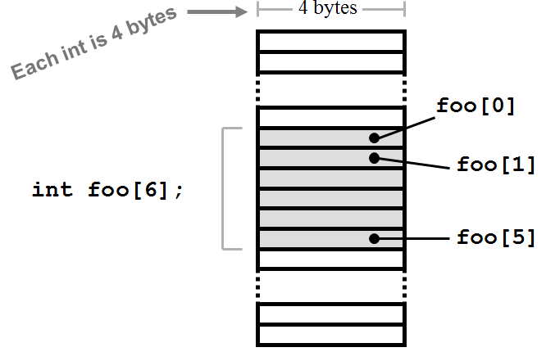
Introduction
An array is a consecutive group of memory locations that all have the same name and the same type.
To refer to a particular location or element in the array , we specify the name of the array and the position number of the particular element in the array.

Slide 3
Declaring Arrays
Arrays occupy space in memory. The programmer specifies the type of each element and the number of elements required by an array as follows:
type arrayName [ arraySize ] ;
For example:
int c [12] ;
int b [100], x[27];

Slide 4
C++ Arrays start at 0 !!!!!!!
The first element is the 0th element!
If you declare an array of n elements, the last one is number n-1.
If you try to access element number n, it is an error!

Slide 6
Array Subscripts
The element numbers are called subscripts.
foo[i]
Array name
subscript
A subscript can be any integer expression:
These are all valid subscripts:
foo[17] foo[i+3] foo[a+b+c]

Slide 7
Initialization
You can initialize an array when you declare it (just like with variables):
int foo[5] = { 1,8,3,6,12};
double d[2] = { 0.707, 0.707};
char s[] = { 'R', 'P', 'I' };
You don’t need to specify a size when initializing,
the compiler will count for you.

Slide 8
Multiple-Subscripted Arrays
Arrays in C++ can have multiple subscripts.
Tables or arrays that require two subscripts to identify a particular element are called double-subscripted arrays.
For example: Double-subscripted array with three rows and four columns

Slide 9
Memory Organization
{
char A[4][3];
A[0][0]
A[0][1]
A[0][2]
A[1][0]
A[1][1]
A[1][2]
A[2][0]
A[2][1]
A[2][2]
A[3][0]
A[3][1]
A[3][2]
A[0]
A[1]
A[2]
A[3]
{
A is an array of size 4.
Each element of A is
an array of 3 chars
{
{

Slide 10
Initialize a Multiple-Subscripted Array
const int NumStudents = 10;
const int NumHW = 3;
double grades[NumStudents][NumHW];
for (int i=0;i<NumStudents;i++) {
for (int j=0;j<NumHW;j++) {
cout << “Enter HW “ << j <<
“ Grade for student number “ << i<< endl;
cin >> grades[i][j];
}
}

Slide 11
Exercise 1
Use a single-subscripted array to solve the following problem.
Read in 20 numbers, each of which is between 10 and 100, inclusive. As each number is read, print it only if it is not a duplicate of a number already read. Provide for the "worst case" in which all 20 numbers are different.
Use the smallest possible array to solve this problem.

Slide 12
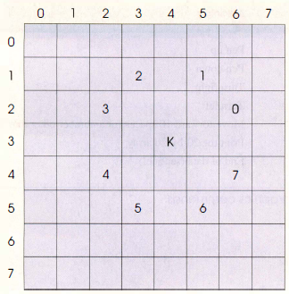
Exercise 2
Draw an 8-by-8 chessboard on the text screen and set a Knight's position by hand. List all positions where the Knight can move to.

Slide 13
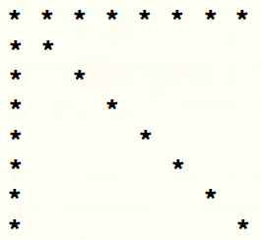
Exercise 3
Draw an 8-by-8 chessboard on the text screen and set a Knight's position by hand. List all positions where the Knight can move to.

Slide 14
Exercise 4
Write single C++ statements that sort an array with 20 elements of type integer.

Slide 15

Any Questions?
 hvusynh@hcmiu.edu.vn

